Slide 1

Scientific Advisory Panel Recommendations with Research Board Appraisal
Doc. 4.3(4)
Prof Amanda Lynch
Chair, Research Board
25 May 2023

Slide 2
Doc. 4.3(4)
Scientific Advisory Panel Recommendations with Research Board Appraisal
Recommendation 1 PAC-2(2022): PAC recommends to EC-76 to request RB to evaluate and prioritize SAP recommendations and advise on their feasibility and concept for implementation.

Slide 3
Doc. 4.3(4)
Scientific Advisory Panel Recommendations with Research Board Appraisal
Research Board Process:
Develop recommendation priority-feasibility matrix

Slide 4
* WCWE = weather, climate, water, environment
Critical
Important
SAP Science and Technology Vision:
Priority-Feasibility Matrix
WMO Mission Priority
Desirable
Non-core
We’re already
doing it
We see a path forward
but needs work
New knowledge
and $ needed
Stretch goal,
decades, billions
Intellectual, Operational and Financial Feasibility

Slide 5
Doc. 4.3(4)
Scientific Advisory Panel Recommendations with Research Board Appraisal
Research Board Process:
Develop recommendation priority-feasibility matrix
Create first cut assessment
Share with INFCOM and SERCOM for feedback
Revise and send to full Research Board using online tool

Slide 6
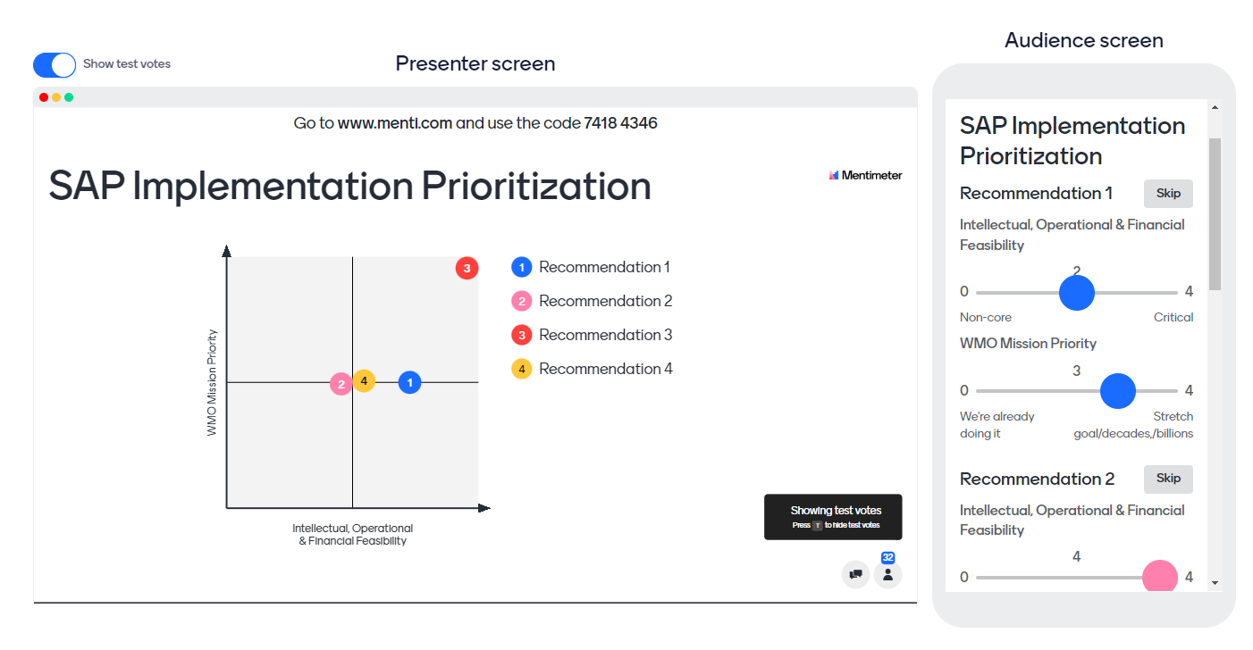
SAP Science and Technology Vision:
Priority-Feasibility Online Tool

Slide 7
Doc. 4.3(4)
Scientific Advisory Panel Recommendations with Research Board Appraisal
Research Board Process:
Develop recommendation priority-feasibility matrix
Create first cut assessment
Share with INFCOM and SERCOM for feedback
Revise and send to full Research Board using online tool
Create summary of input for full board discussion

Slide 8
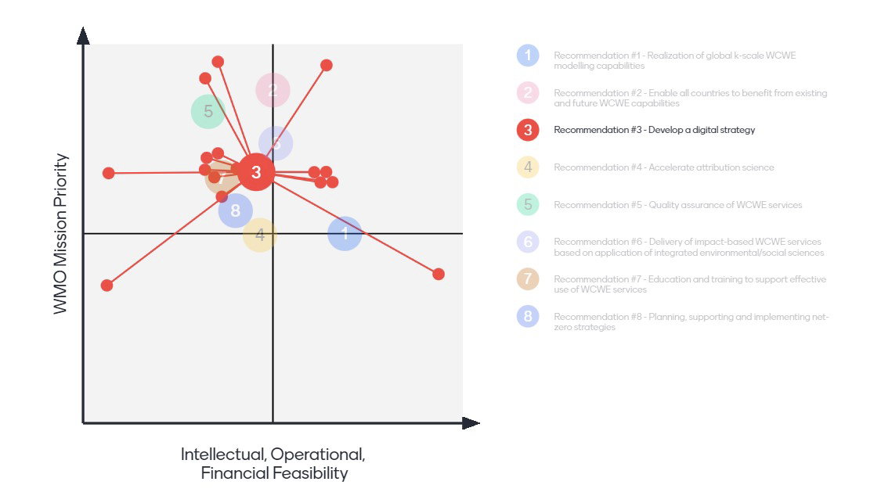
SAP Science and Technology Vision:
Priority-Feasibility Matrix
Recommendation 3: Develop a Digital Strategy...enable the equitable exploitation of cloud computing and artificial intelligence and machine learning... for low-income countries to access and exploit the outputs arising from Recs 1 and 2.
Critical
example
TCs
Important
WMO Mission Priority
Desirable
* WCWE = weather, climate, water, environment
Non-core
We’re already
doing it
We see a path forward
but needs work
New knowledge
and $ needed
Stretch goal,
decades, billions
Intellectual, Operational and Financial Feasibility
Notes:
The median position here seems ok

Slide 9
Doc. 4.3(4)
Scientific Advisory Panel Recommendations with Research Board Appraisal
Research Board Process:
Develop recommendation priority-feasibility matrix
Create first cut assessment
Share with INFCOM and SERCOM for feedback
Revise and send to full Research Board using online tool
Create summary of input for full board discussion
Resolve differences in assessments to create a final appraisal
Expand on conditioning factors for appraisal document
Write final report (Doc 3.3(4) annex)

Slide 10
Doc. 4.3(4)
Scientific Advisory Panel Recommendations with Research Board Appraisal

Slide 11
Doc. 4.3(4)
Scientific Advisory Panel Recommendations with Research Board Appraisal
no recommendations are already sufficiently mature
no recommendations are non-core

Slide 12
Doc. 4.3(4)
Scientific Advisory Panel Recommendations with Research Board Appraisal
Research Board Implementation Recommendations in Priority Order:
SAP Recommendation #2 be further developed by the Capacity Development Panel through a nuanced and pragmatic assessment of developing local capacity, along with a concept note regarding implementation strategies;
SAP Recommendation #6 be advanced through a concept note developed by the Research Board on pathways to enable closer integration of geophysical and social sciences;
SAP Recommendation #5 be advanced by SERCOM as part of a globally consistent quality assurance process for WCWE Services from private providers, to best align provider standards with NMHSs;
SAP Recommendation #3 be advanced, guided by existing Research Board Concept Notes, as part of a whole of UN perspective on digital strategy;
SAP Recommendation #7 to be developed with the leadership of the Education and Training Office to develop partnerships for integrative educational best practices with support from the Capacity Development Panel;
SAP Recommendation #4 (attribution research) be continued through regular Research Board activities;
SAP Recommendation #8 highlighting leadership in attaining net-zero to continue as part of the Green WMO.
Recommendation #1 discussed next...
Notes:
Major International Climate Research and Development Effort in the Exploitation of Global kilometer (k-Scale) Computing and Earth System Observations
Bridge the Gap Between Developing Global Science and Delivering Local Impact
Develop a Digital Strategy
Accelerate the Development of Attribution Science
Development of Quality Assurance Strategy for Weather, Climate and Water-Related Services
Work Across Agencies to Enable Closer Integration of Geophysical and Social Sciences to Support Better Understanding of the Impacts of Weather, Climate and Water Events
Develop Education and Training Strategies to Broaden Expertise Beyond Traditional Disciplines
WMO, Together with NMHSs, Provide Leadership in the Move Towards Net-Zero

Slide 13
Doc. 4.3(4)
Scientific Advisory Panel Recommendations with Research Board Appraisal
Major international climate research and development effort in the exploitation of global kilometre (k-scale) computing and Earth-system observations. Elements of appraisal include:
  10+ atmosphere-land k-scale climate models already running, showing benefits to deep convection;
  outstanding questions in hydrology, ocean, ice, shallow convection, and approaches to system component coupling;
  required computational, data and network capacities and software engineering for fully coupled finescale grid implementations are massive;
  many countries have limited or no access to the data we currently provide on weather and climate scales.
In addition, the RB considered:
  exciting and mission-critical research in sub-seasonal to seasonal prediction, and
  the likely disruption of traditional approaches from machine learning and artificial intelligence methods.

Slide 14
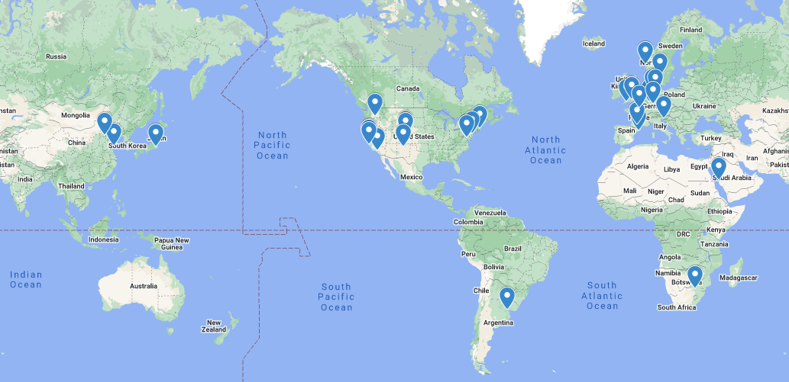
Map of self-Identified locations of 5km or finer resolution global and regional models, either coupled or single components of the Earth System (WCRP Report).
Doc. 4.3(4)
Scientific Advisory Panel Recommendations with Research Board Appraisal

Slide 15
Doc. 4.3(4)
Scientific Advisory Panel Recommendations with Research Board Appraisal
Major international climate research and development effort in the exploitation of global kilometre (k-scale) computing and Earth-system observations.
The value proposition of this particular approach is not yet clear, and the World Climate Research Programme Lighthouse Activity Digital Earths is already effectively mobilizing the research community. Hence the Research Board proposes:
  SAP Recommendation #1 be further developed with the leadership of
  the World Climate Research Programme, with the support of the Research Board, the Scientific Advisory Panel, INFCOM and SERCOM, in order to coordinate and promulgate relevant research and development for climate simulation and analysis capabilities that support WMO Member strategic priorities.
But because there are other emerging approaches (e.g. AI) and critical foci (e.g. S2S) this is not top priority.

Slide 16
Doc. 4.3(4)
Scientific Advisory Panel Recommendations with Research Board Appraisal
Research Board Implementation Recommendations in Priority Order:
SAP Recommendation #2 be further developed by the Capacity Development Panel through a nuanced and pragmatic assessment of developing local capacity, along with a concept note regarding implementation strategies;
SAP Recommendation #6 be advanced through a concept note developed by the Research Board on pathways to enable closer integration of geophysical and social sciences;
SAP Recommendation #5 be advanced by SERCOM as part of a globally consistent quality assurance process for WCWE Services from private providers, to best align provider standards with NMHSs;
SAP Recommendation #3 be advanced, guided by existing Research Board Concept Notes, as part of a whole of UN perspective on digital strategy;
SAP Recommendation #7 to be developed with the leadership of the Education and Training Office to develop partnerships for integrative educational best practices with support from the Capacity Development Panel;
SAP Recommendation #4 (attribution research) be continued through regular Research Board activities;
SAP Recommendation #8 highlighting leadership in attaining net-zero to continue as part of the Green WMO;
SAP Recommendation #1 be further developed with the leadership of the World Climate Research Programme.
Notes:
Major International Climate Research and Development Effort in the Exploitation of Global kilometer (k-Scale) Computing and Earth System Observations
Bridge the Gap Between Developing Global Science and Delivering Local Impact
Develop a Digital Strategy
Accelerate the Development of Attribution Science
Development of Quality Assurance Strategy for Weather, Climate and Water-Related Services
Work Across Agencies to Enable Closer Integration of Geophysical and Social Sciences to Support Better Understanding of the Impacts of Weather, Climate and Water Events
Develop Education and Training Strategies to Broaden Expertise Beyond Traditional Disciplines
WMO, Together with NMHSs, Provide Leadership in the Move Towards Net-Zero

Slide 17

Thank you
^{wmo.int}

